Slide 1

KLE Technological University
Queue
II Semester
18ECSP102– Problem Solving with Data Structures
Queue
2020-2021

Slide 2

Queue
Class Activity -1
How the tokens are issued to the customers?
How a person joins or leaves the queue ?

Slide 3
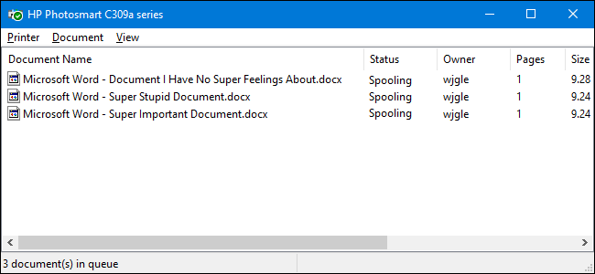
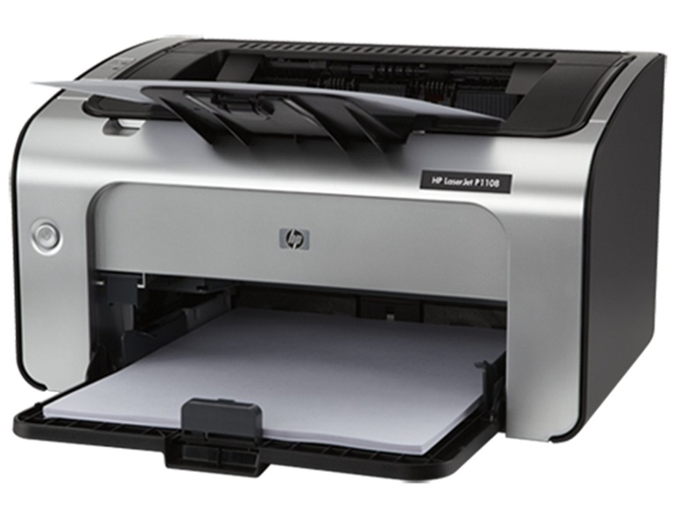
Queue
Class Activity -2

Slide 4
Queue
What is Queue??
A queue is a linear data structure.
Additions are made at the end(tail or rear) of the queue
while deletions are made from the front(head) of the queue.
Elements are accessed in FIFO order (First-In First-Out)
Types of queue
Linear queue
Circular queue
Priority queue
Double ended queue

Slide 5
Queue
Queue Operations
Operation | Description
dequeue | Removes an element from the front end of queue
enqueue | Adds an element to the rear end of queue
isEmpty | Determines whether the queue is empty
isFull | Determines whether the queue is full

Slide 6
Queue
Conceptual View of a Queue
Adding an element
Front of queue
New element is added to the rear end of queue

Slide 7
Queue
Conceptual View of a Queue
Removing an element
New front element of queue
Element is removed from the front end of queue

Slide 8
Queue
Queue implementation using array
typedef struct{
int front,rear;
int elements[MAX];
}queue;
int isfull(queue *);
int isempty(queue *);
void enqueue(queue *,int);
void dequeue(queue *);
void display(queue *);

Slide 9
Queue
Full and empty functions
int isfull(queue *pq)
{
if((pq->front==0)&&(pq->rear==MAX-1))
return 1;
else
return 0;
}
int isempty(queue *pq)
{
if(pq->front==-1)
return 1;
else
return 0;
}

Slide 10
Queue
Enqueue function Dequeue function
void dequeue(queue *pq)
{
    int temp;
    temp=pq->elements[pq->front];
    if(pq->front==pq->rear) pq->front=pq->rear=-1;
    else
    pq->front++;
    printf("deleted val is %d",temp);
}
void enqueue(queue *pq,int element)
{ int i;
if(pq->front==-1) pq->front=pq->rear=0;
else
pq->rear++;
pq->elements[pq->rear]=element;
}
Display function
void display(queue *pq)
{
    int i;
    for(i=pq->front;i<=pq->rear;i++)
    printf("%d\t",pq->elements[i]);
}

Slide 11
Queue
Queue implementation
1.Using Arrya of structures
2. Using Linked List

Slide 12
Queue
Queue implementation using List
Insert_rear()
Delete_front()
Display()

Slide 13

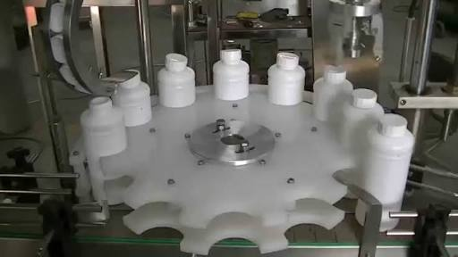
Queue
Exercise
1) Implement Toll bay for vehicles.
Note : LMV – 50 Rs, HMV- 100 Rs.
Read & Display
Display only HMV vehicle details.
Count LMV vehicles only.
2) Capping of bottles in Cold-drink company.
Read & Display
Display only Uncapped bottles.
Count total number of capped bottles.

Slide 14
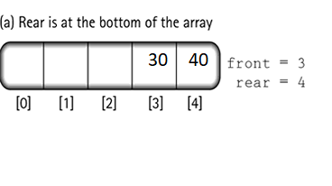
Queue
Disadvantages of queue
Even if memory locations at the beginning of queue are available elements can’t be inserted.

Slide 15

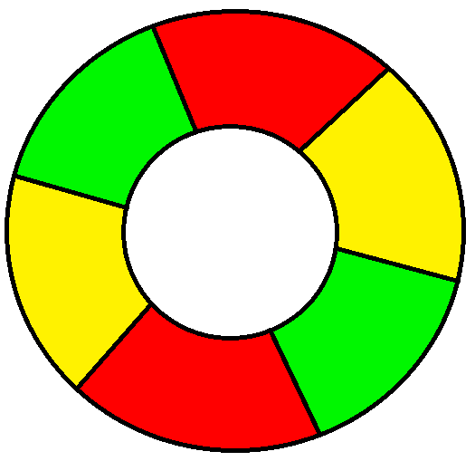
Queue
Class Activity -3
How Traffic Signal System works?
Traffic Signal System uses circular queue.

Slide 16
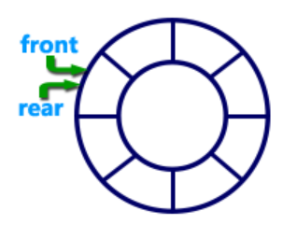
Queue
Circular queue
Circular queue is a linear data structure.
It works based on FIFO (First In First Out) principle.

Slide 17
Queue
Examples of Circular queue
Regular routine of life is an example of circular queue.
Eating - breakfast, lunch, snacks, dinner - breakfast….
Days in a week - Sunday - Saturday - Sunday ….
Months in a year - Jan - Dec- Jan …

Slide 18
Queue
Circular queue Implementation using array
#define MAX 10
typedef struct Q
{
int rear,front;
int elements[MAX];
}queue;
int empty(queue *pq);
int full(queue *pq);
void enqueue(queue *pq,int x);
int dequeue(queue *pq);
void print(queue *pq);

Slide 19
Queue
Full and empty functions
int empty(queue *pq)
{
if(pq->rear==-1)
return(1);
return(0);
}
int full(queue *pq)
{
if((pq->rear+1)%MAX==pq->front)
return(1);
return(0);
}

Slide 20
Queue
Enqueue function
void enqueue(queue *pq,int x)
{
  if(pq->rear==-1)
  {
  pq->rear=pq->front=0;
  pq->elements[pq->rear]=x;
  }
  else
  {
  pq->rear=(pq->rear+1)%MAX;
  pq->elements[pq->rear]=x;
}
}

Slide 21
Queue
Dequeue function
int dequeue(queue *pq)
{
  int x;
  x=pq->elements[pq->front];
  if(pq->rear==pq->front)
  {
  pq->rear=-1;
  pq->front=-1;
  }
  else
  pq->front=(pq->front+1)%MAX;
  return(x);
}

Slide 22
Queue
Display function
void print(queue *pq)
{
  int i;
  if(!empty(pq))
  {
  printf("\n");
  for(i=pq->front;i!=pq->rear;i=(i+1)%MAX)
  printf("%d\t",pq->elements[i]);
  printf("%d\t",pq->elements[i]);
  }
}

Slide 23

Queue
Circular queue using linked list
Circular queue is also called as Ring Buffer.
In a circular queue, all nodes are treated as circular. Last node is connected back to the first node.
Circular queue contains a collection of data which allows insertion of data at the end of the queue and deletion of data at the beginning of the queue.

Slide 24
Queue
Circular queue Implementation using linked list
struct node
{
  int data;
  struct node *next;
  };
Operations of Circular queue
Insert_end()
Delete_front()
Display()

Slide 25
Queue
Examples
Implement Round-robin scheduling algorithm.
Implement musical chair game.
Implement music-player system.

Slide 26
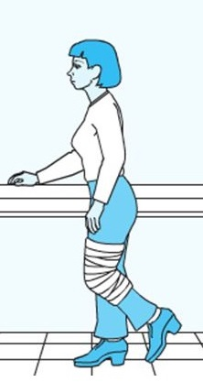
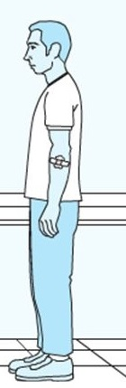

Queue
Class Activity -3
How the order of treatment will be given to the patients?

Slide 27
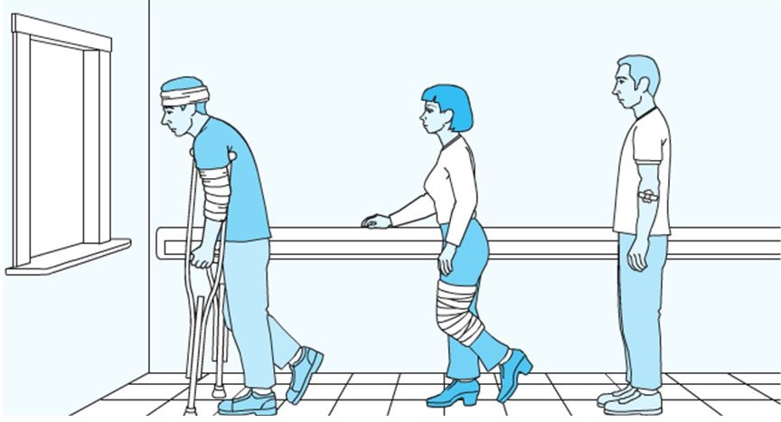
Queue
Continued..
I can stand for a long time
3
I can stand for some time.
2
I cant stand.
1

Slide 28
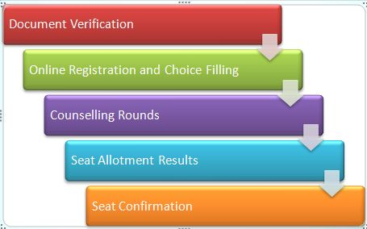
Queue
Class Activity -4

Slide 29
Queue
Examples on priority queue
Document verification in CET counseling process.
Selection of colleges depending on CET rank. ( Rank is considered as priority).
Ticket counter line where people who come first will get his ticket first.( based on time).
Zomato provides additional discount for regular customers.

Slide 30
Queue

Slide 31
Queue

Slide 32
Queue

Slide 33
Queue

Slide 34
Queue

Slide 35
Queue

Slide 36
Queue

Slide 37
Queue

Slide 38
Queue

Slide 39
Queue

Slide 40
Queue

Slide 41
Queue

Slide 42
Queue

Slide 43
Queue

Slide 44
Queue

Slide 45
Queue

Slide 46
Queue

